Slide 1
The Business Analytics Model
Business Intelligence & Analytics

Slide 2
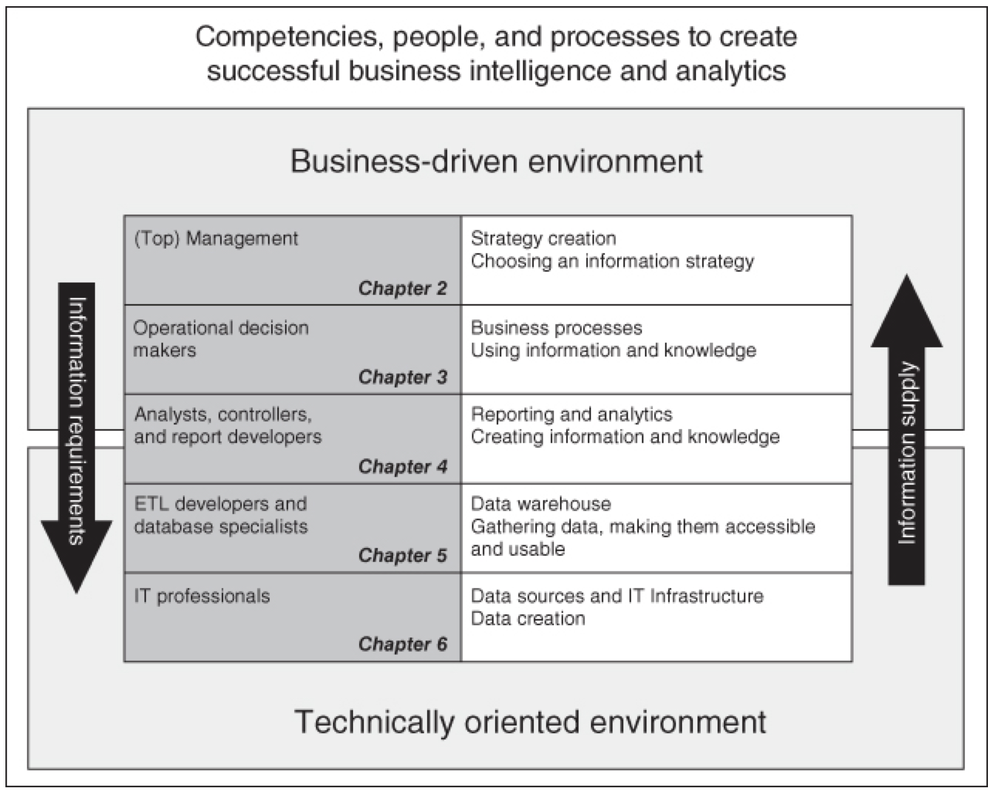

Slide 3


